Slide 1
Where do young people want to live?
Minzhi Meng

Slide 2
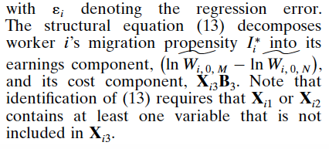

1. The Migration of Young Adults from Non-Metropolitan Counties
Thesis: examines young adult migration from non-metropolitan counties to either different non-metropolitan counties or to metropolitan areas.
Data: The primary data source for the study is the NLSY, a unique panel of 12,686 individuals 14 to 21 years of age in 1979 that has been re-surveyed annually
Model:

Slide 3
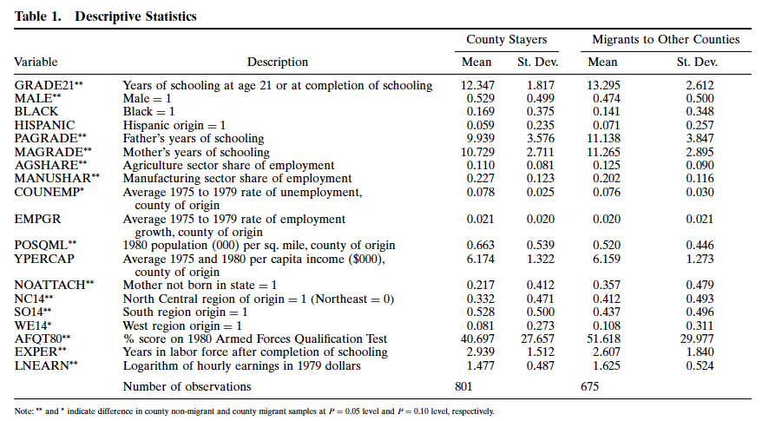
Conclusions:

Slide 4
2. The regional migration of young adults in England and Wales (2002–2008): a ‘conveyor-belt’ of population redistribution?
Thesis: calls for a more encompassing perspective of the regional migration patterns of young adults (16–24), extending studies of labour-motivated graduate migration.
Data: revised internal migration estimates for England and Wales mid-2001–mid-2002 to mid-2007–mid-2008, published by the Office for National Statistics on 13 May 2010.

Slide 5
Method: calculated changes at the local authority level by comparing
‘snap-shot’ cross-sections of GP registers, taken on 31st of each year (from the NHS Central Register – NHSCR). A move is identified by matching each patient’s NHS number between these cross-sections, and checking for changes to the postcode indicating that the individual has moved to a different local authority (adjusted for entering and graduating migration).

Slide 6
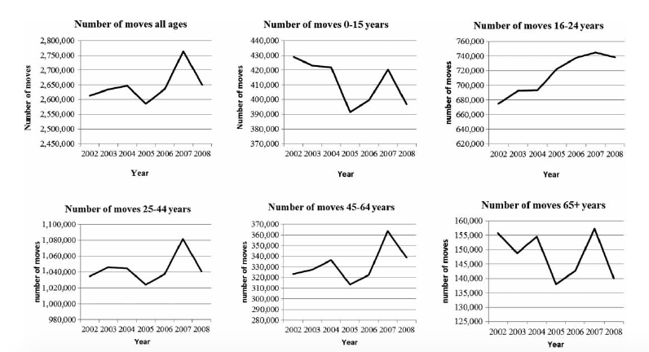
Conclusion:

Slide 7
Are Millennials Coming to Town? Residential Location Choice of Young Adults
It documents the demographic shifts from 1990 to 2015 by distance from the central business districts (CBDs) of the 50 largest U.S. metros.

Slide 8
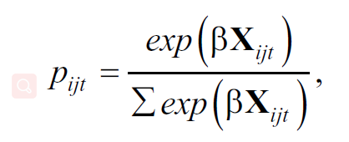
Data:
U.S. Census Bureau (2012)
2015 American Community Survey (ACS)
Methodology:
Multinomial Logit

Slide 9
Dependent:
(1) city center (2–3 miles from CBD)
(2) inner city (3–10 miles)
(3) suburban area (10–45 miles)
(4) rest of country (45 miles and farther away)
Independent:
Age, Year FE, Age × Year FEs, gender, race, education, employment, etc
Results show that millennials tend to prefer city centers.

Slide 10
URBAN REVIVAL IN AMERICA, 2000 TO 2010
This paper documents and explains the striking rise in the proclivity of college-educated individuals to reside near city centers since 2000. They show that this recent urban revival is driven almost entirely by younger college graduates in larger cities.
Data:LTDB, ACS

Slide 11
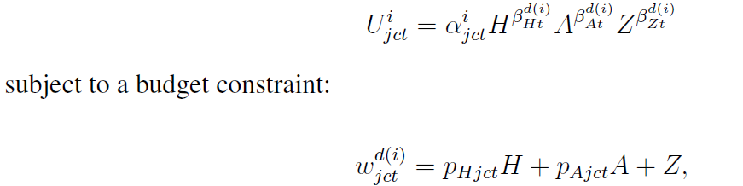
Model:

Slide 12
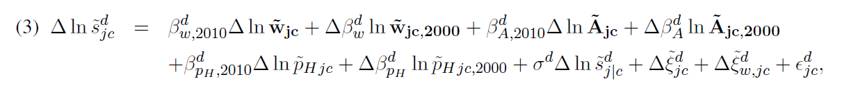
They estimated this equation using IVs and find that residencial choice of young people are largely affected by consumption amenities.

Slide 13
Are millennials moving to more urbanized and transit-oriented counties?
Thesis: This study examines the county-to-county migration pattern of Americans aged 25-34. It additionally analyzes the migration pattern of people aged 35-64 so that the comparison can be made between these two age groups.
Sample selection: In this paper, the group aged 25-34 was used as representative of millennials. The people aged between 35-64 are set as comparison group.
Data: US Census Bureau's’ County-to-County Migration Flows: 2015 ACS, and Bureau’s American FactFinder.

Slide 14
Methodology: This paper used push-pull model (OLS). It used natural log of county to county migration in one year as dependent variable, and examined how the share of urbanized area population, density of dwelling units, and share of single detached homes, as well as the share of community trips by transit, walking and driving alone. Also, some control variables are added such as median building age, shares of population age 25 and over with bachelor’s education, and ratio of median household income to median home value.
Conclusion: Millennials tend to be attracted by counties with larger share of urbanized area population, higher dwelling density, lower share of single detached homes, higher share of transit trips, and lower share of drive-alone trips.

Slide 15
Determinants of Residential Satisfaction: Ordered Logit vs. Regression Models (Max Lu 1998)
Data: 1989 American Housing Survey (AHS) national sample
(55,000 housing units from throughout the United States. )
Dependent variable: housing satisfaction
measured by a respondent’s answer to the question: “On a scale of 1 to 10, how would you rate the house (or apartment) as a place to live? 10 is best, 1 is worst?”
ordinal nature
Exploratory variables: Individual attributes (age, race, education), Housing, neighborhood and locational variables
Methodology: ordered logit models (OLM)

Slide 16
ordered logit model
It can be thought of as an extension of the logistic regression model that applies to dichotomous dependent variables, allowing for more than two (ordered) response categories.
proportional odds assumption

Slide 17
Contrasting the results from regression analysis.
Regression models are problematic when the dependent variables are ordinal responses because the usual assumptions for regression are generally not met. The regression technique often fails to model the true, nonlinear relationship in the data. It is likely to underestimate the relative impact of certain explanatory variables on satisfaction.
For ordinal dependent variables, the appropriate model is the ordered logit or probit model, which takes the ceiling and floor effects into account and avoids the use of a subjectively chosen scores assigned to the categories.

Slide 18
Finding the “Generationed City”
The Form and Structure of Young Adult Settlement Patterns
Thesis：This paper examines the present patterns in the residential geographies of young adults in major cities in Canada and the United States. It explains how the differences and similarities in young adult residential patterns across metropolitan regions are shaped by the wider context of post-Fordist economic restructuring, urban planning, and the neoliberal remaking of the city.
Data: 2011 Canadian and 2010 US Census. Demographic data is analysed at the dissemination area level in Canada and the census block group level in the United States

Slide 19
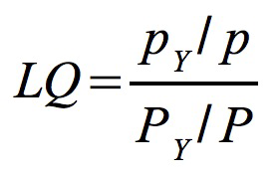
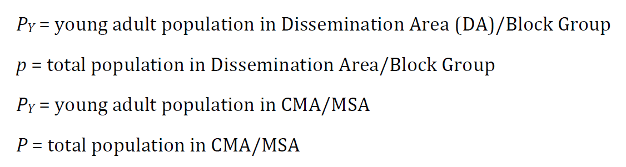
Model:
To observing residential settlement:

Slide 20
Conclusion:
This paper suggest that young adults are responsive to dense housing form, urban amenities and transit provision in both central areas and extending into suburban reaches. In major metropolitan regions in the United States and Canada young adults live centrally. In North American metro regions, downtown represents an important centre of young adult living.

Slide 21
Questions:
Two steps: where + why
What is the dependent variable?
Datasets

